Slide 1

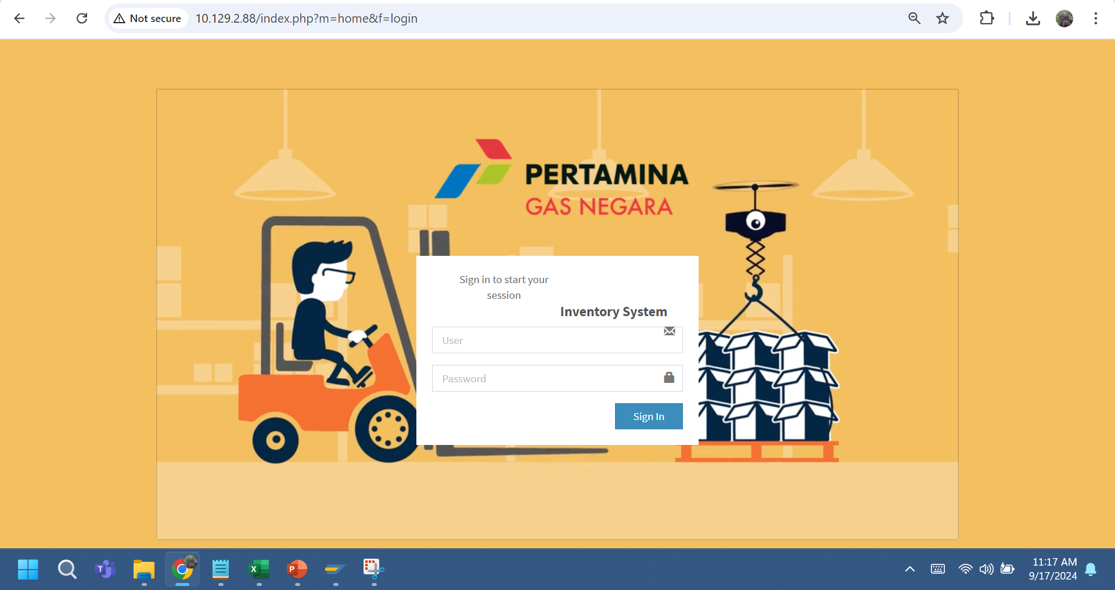
APLIKASI SIMACIGAS HALAMAN LOGIN
Link Aplikasi SIMACIGAS : http://10.129.2.88/index.php?m=home&f=login
Submiter CGP
User:nur.rahmani
Approval 1 KOPM CGP
User : janter.halasan
Password : 12345
Approval 2 CGP
User : suhaini.aslamayani
Password : 12345
Submiter
Gudang Klender
User : gd.klender
Password : 12345
Approvall
Gudang Klender
User : kepalagudang.klender
Password :12345

Slide 2
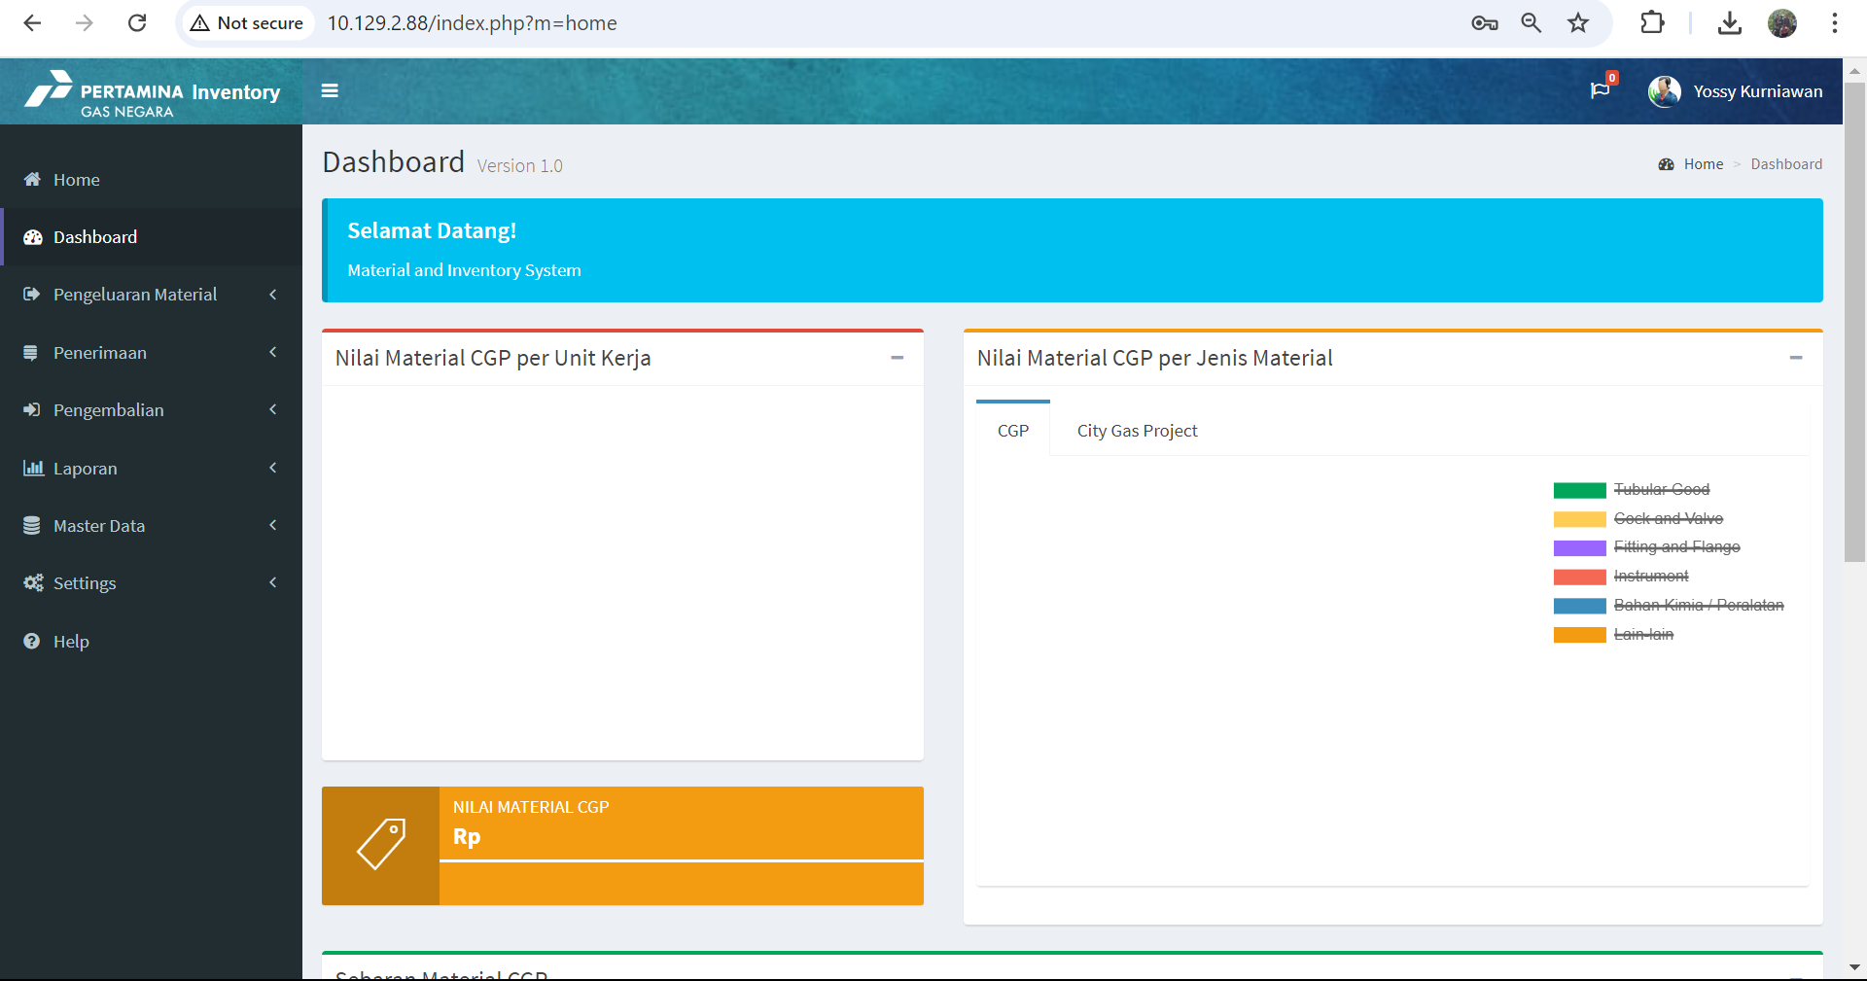
DASHBOARD SIMACIGAS

Slide 3
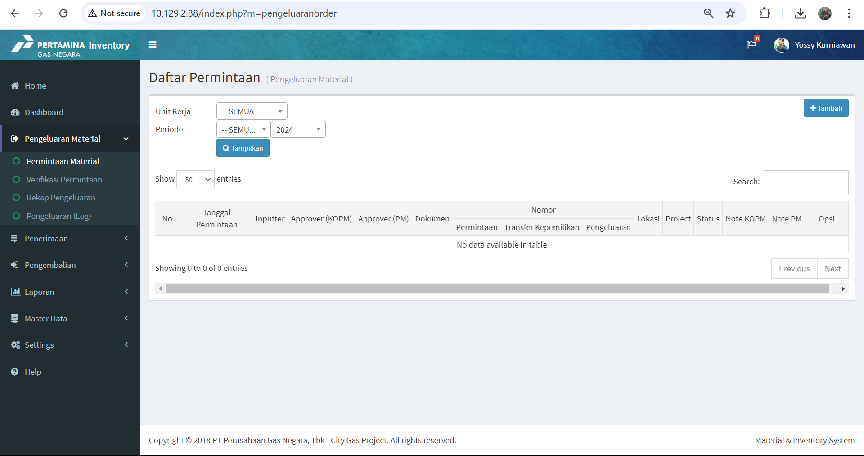
MODULE PENGELUARAN MATERIAL SIMACIGAS

Slide 4
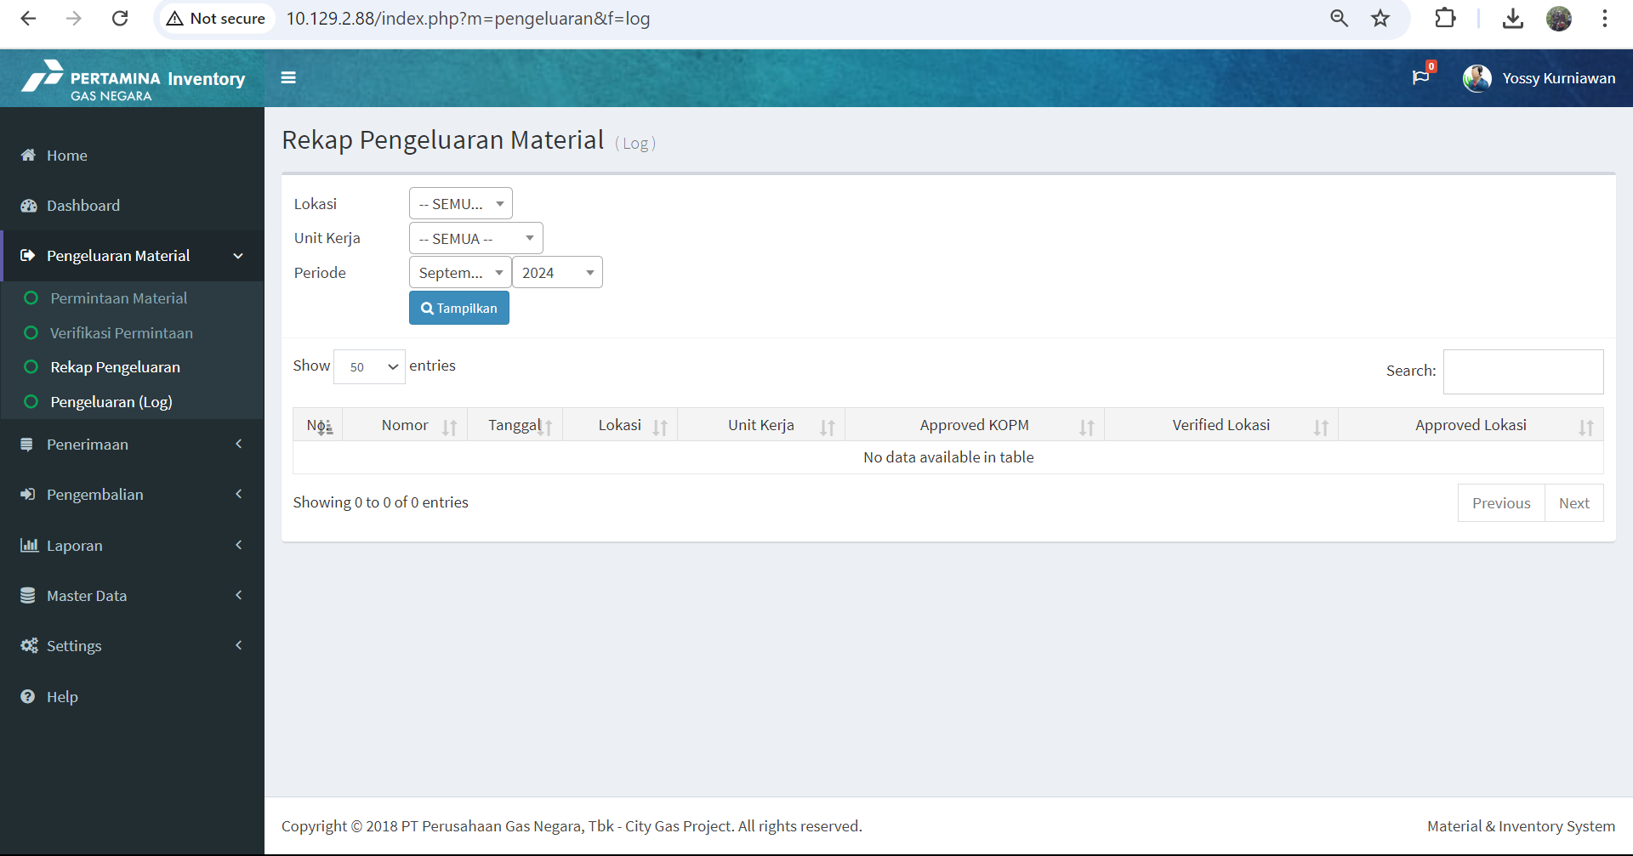
MODULE PENGELUARAN MATERIAL SIMACIGAS

Slide 5
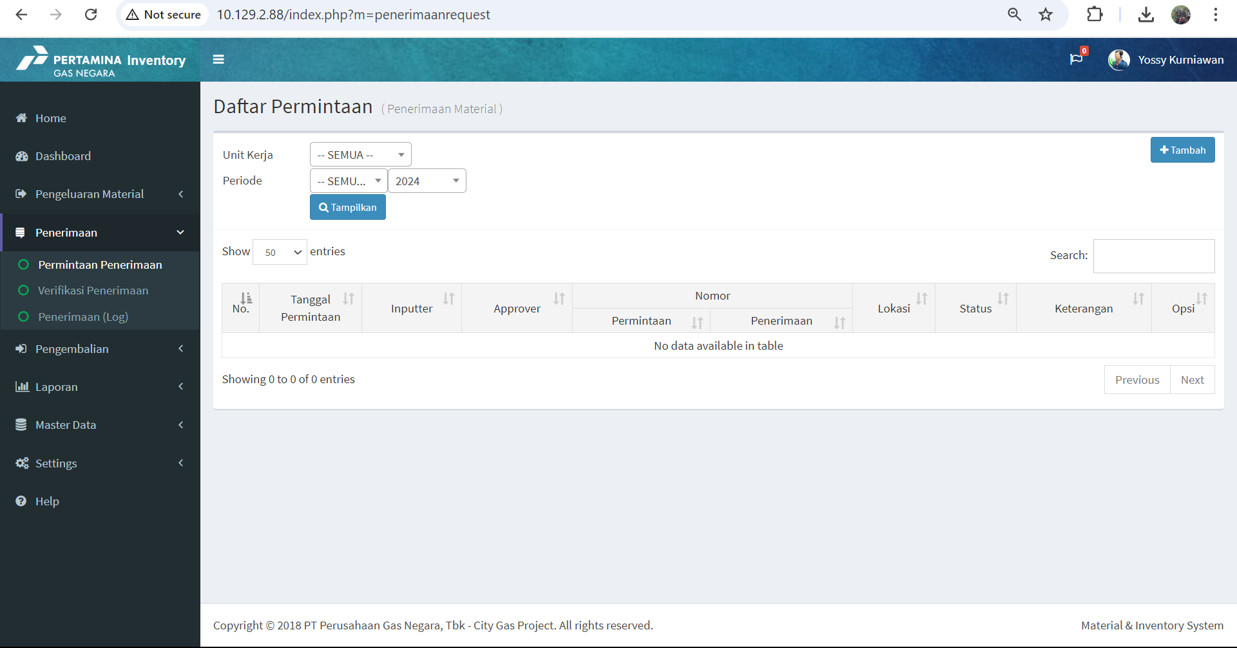
MODULE PENERIMAAN MATERIAL SIMACIGAS

Slide 6
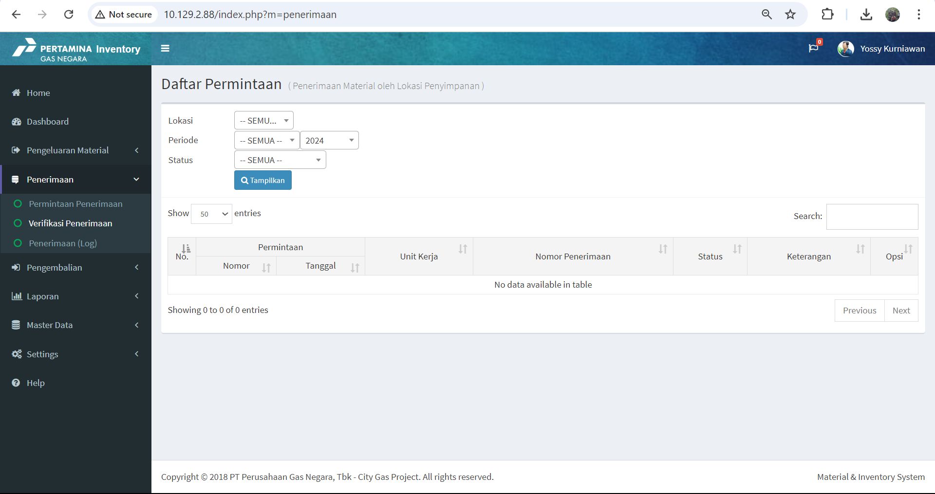
MODULE PENERIMAAN MATERIAL SIMACIGAS

Slide 7
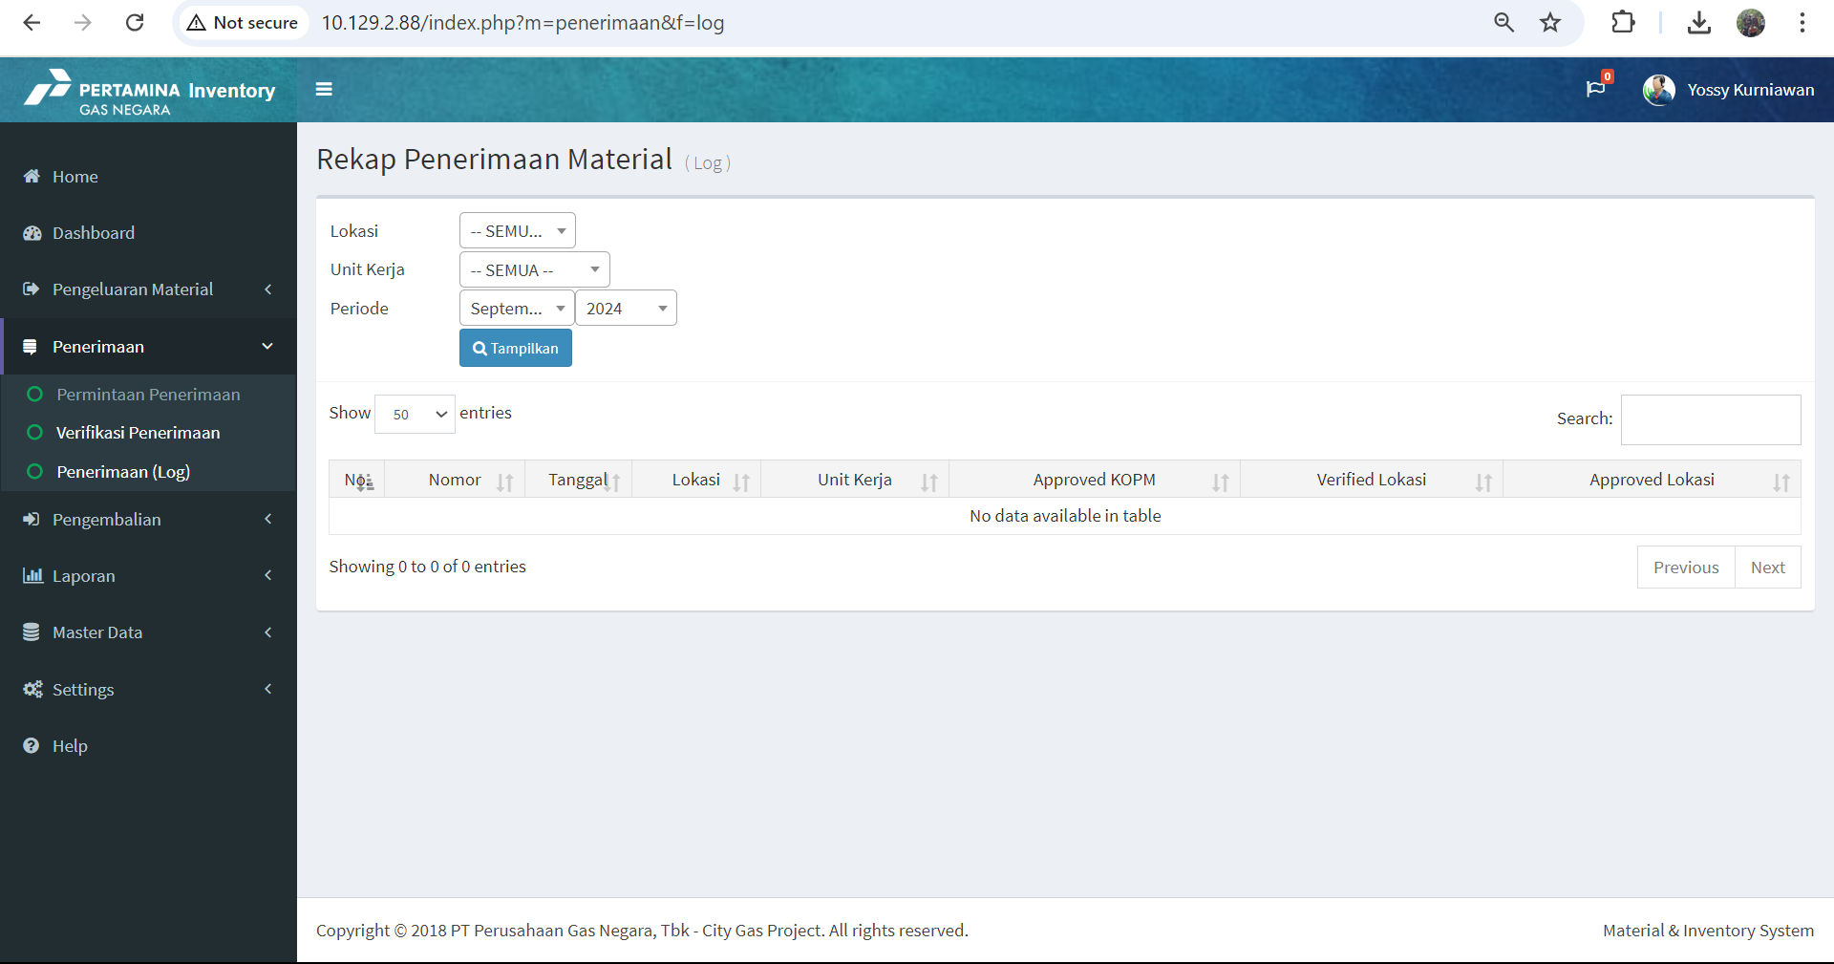
MODULE PENERIMAAN MATERIAL SIMACIGAS

Slide 8

MODULE PENGEMBALIAN MATERIAL SIMACIGAS

Slide 9
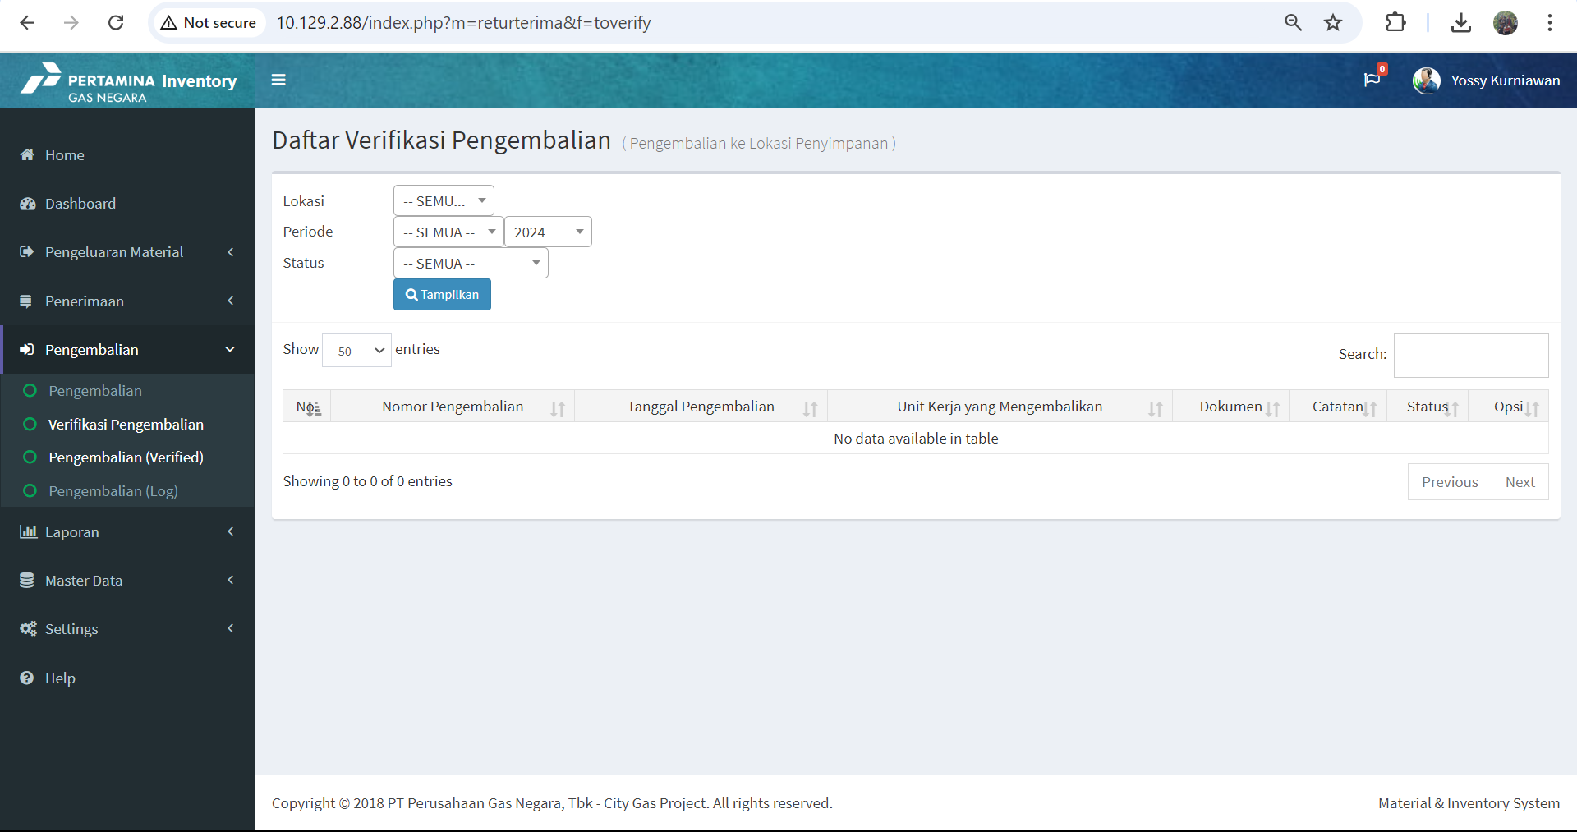
MODULE PENGEMBALIAN MATERIAL SIMACIGAS

Slide 10
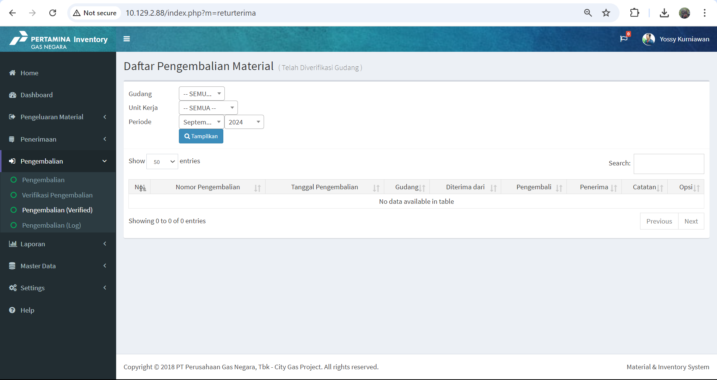
MODULE PENGEMBALIAN MATERIAL SIMACIGAS

Slide 11

MODULE PENGEMBALIAN MATERIAL SIMACIGAS

Slide 12
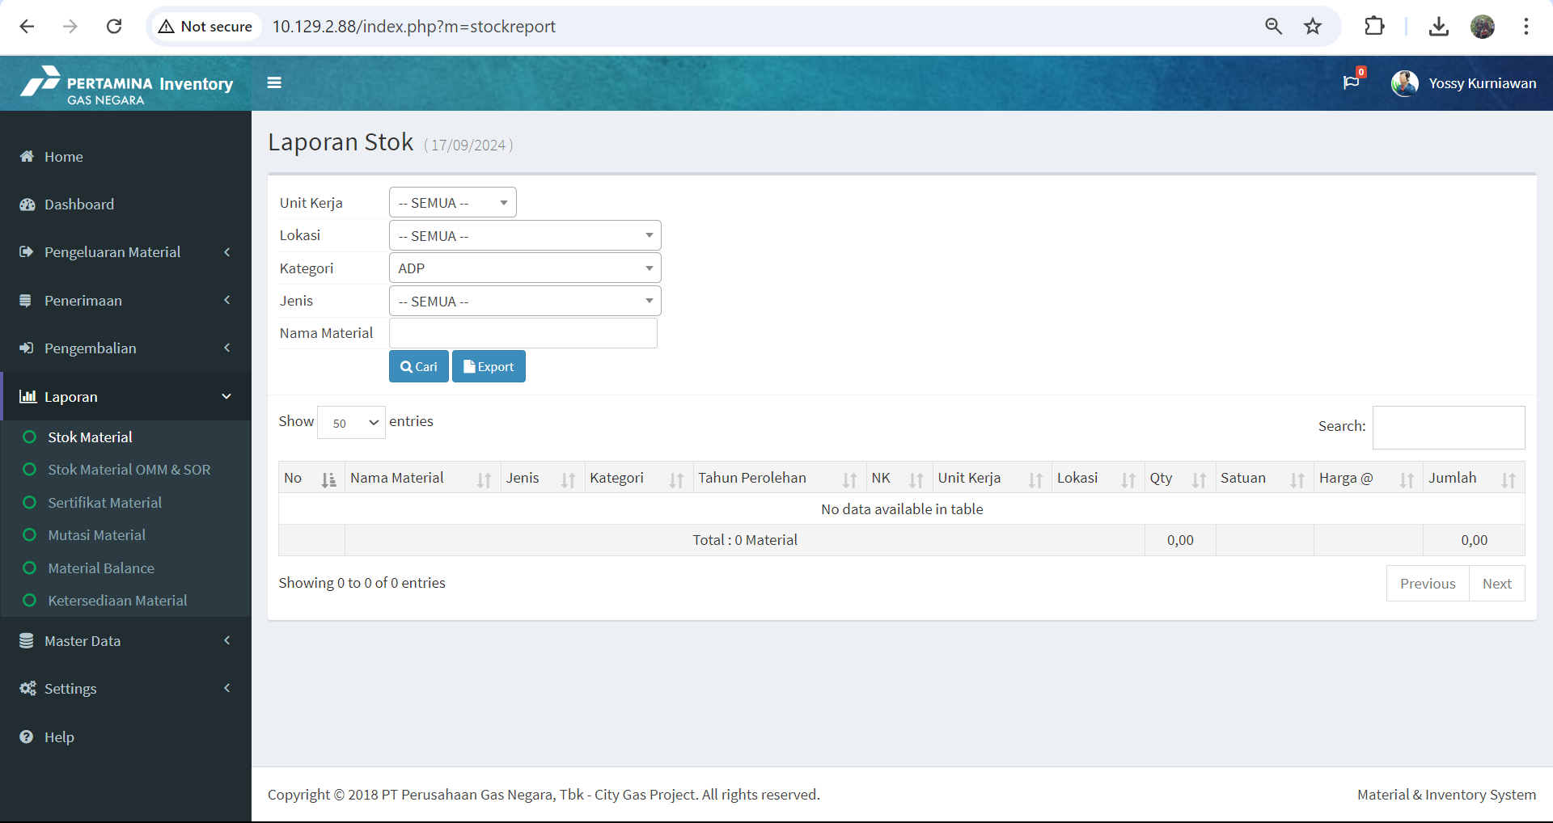
MODULE LAPORAN SIMACIGAS

Slide 13
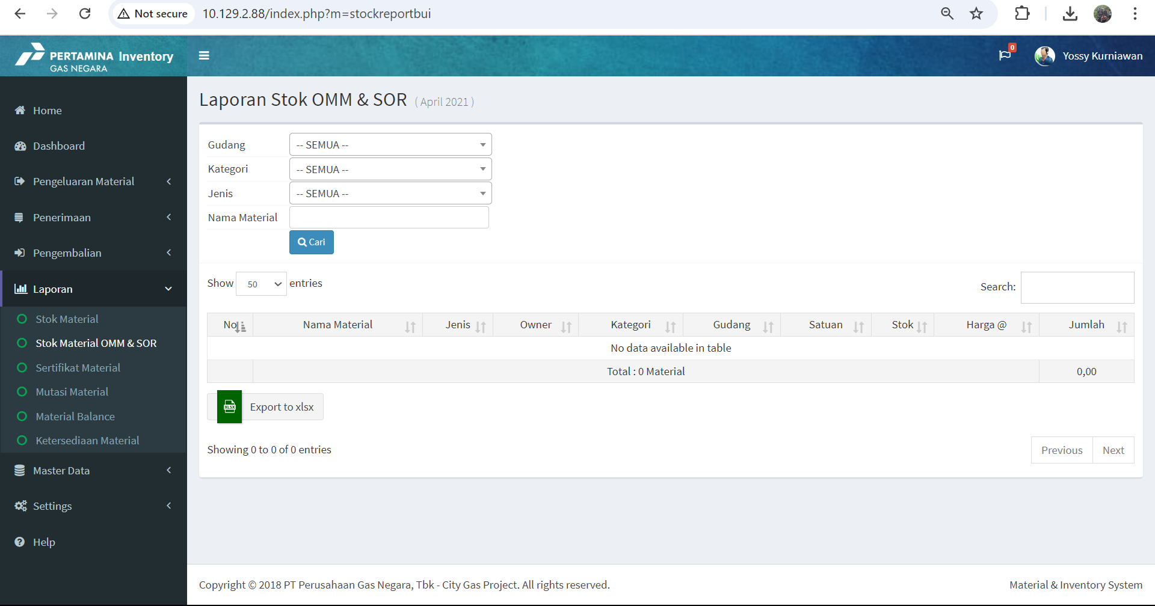
MODULE LAPORAN SIMACIGAS

Slide 14
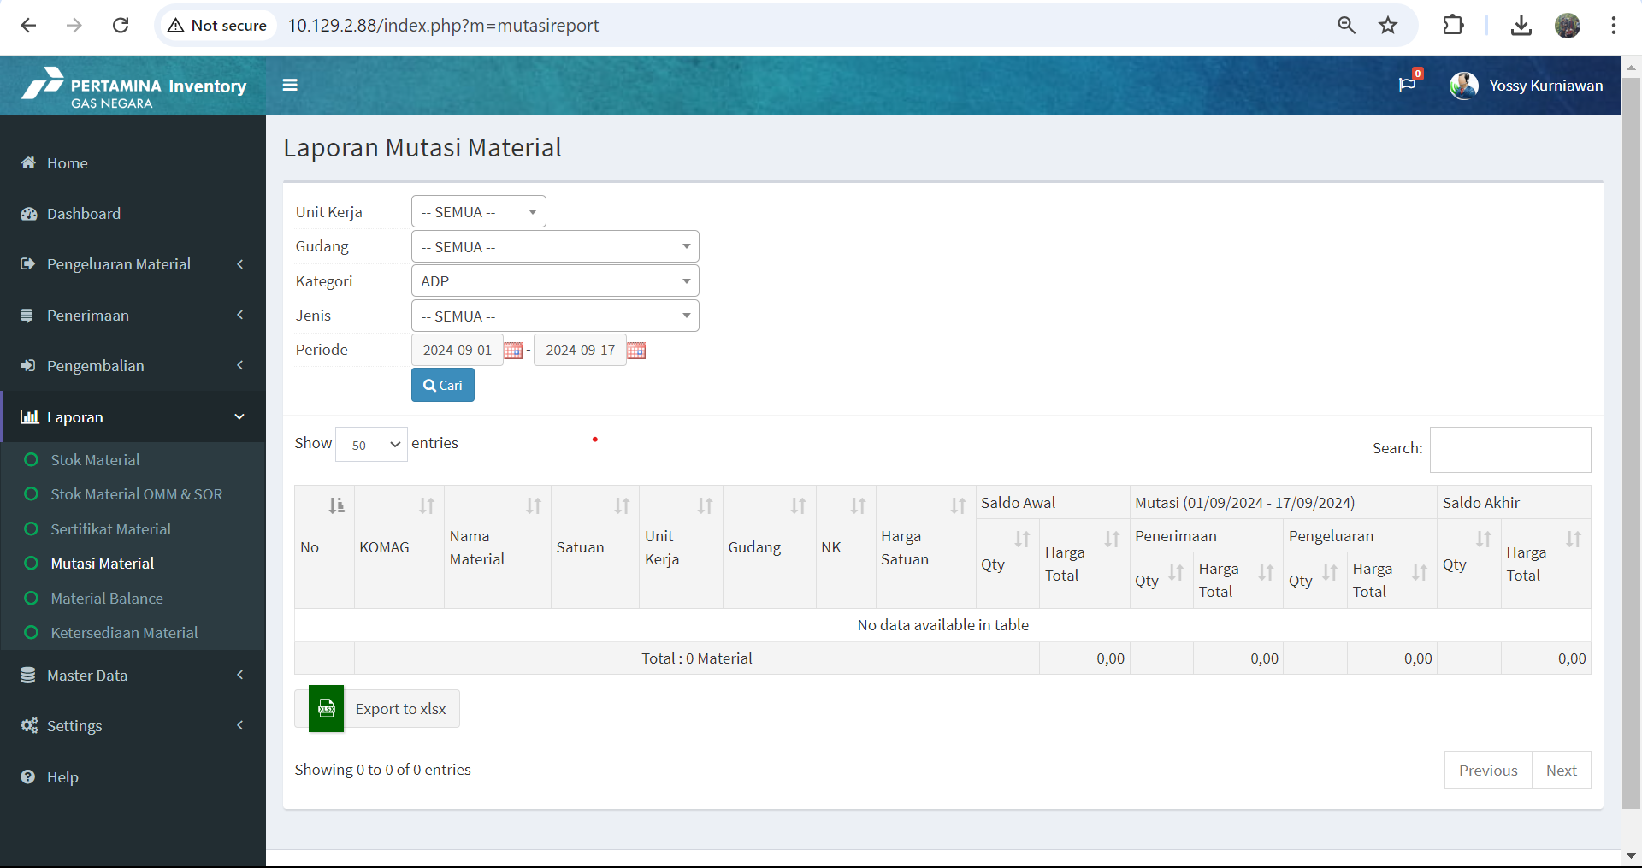
MODULE MASTER DATA SIMACIGAS

Slide 15
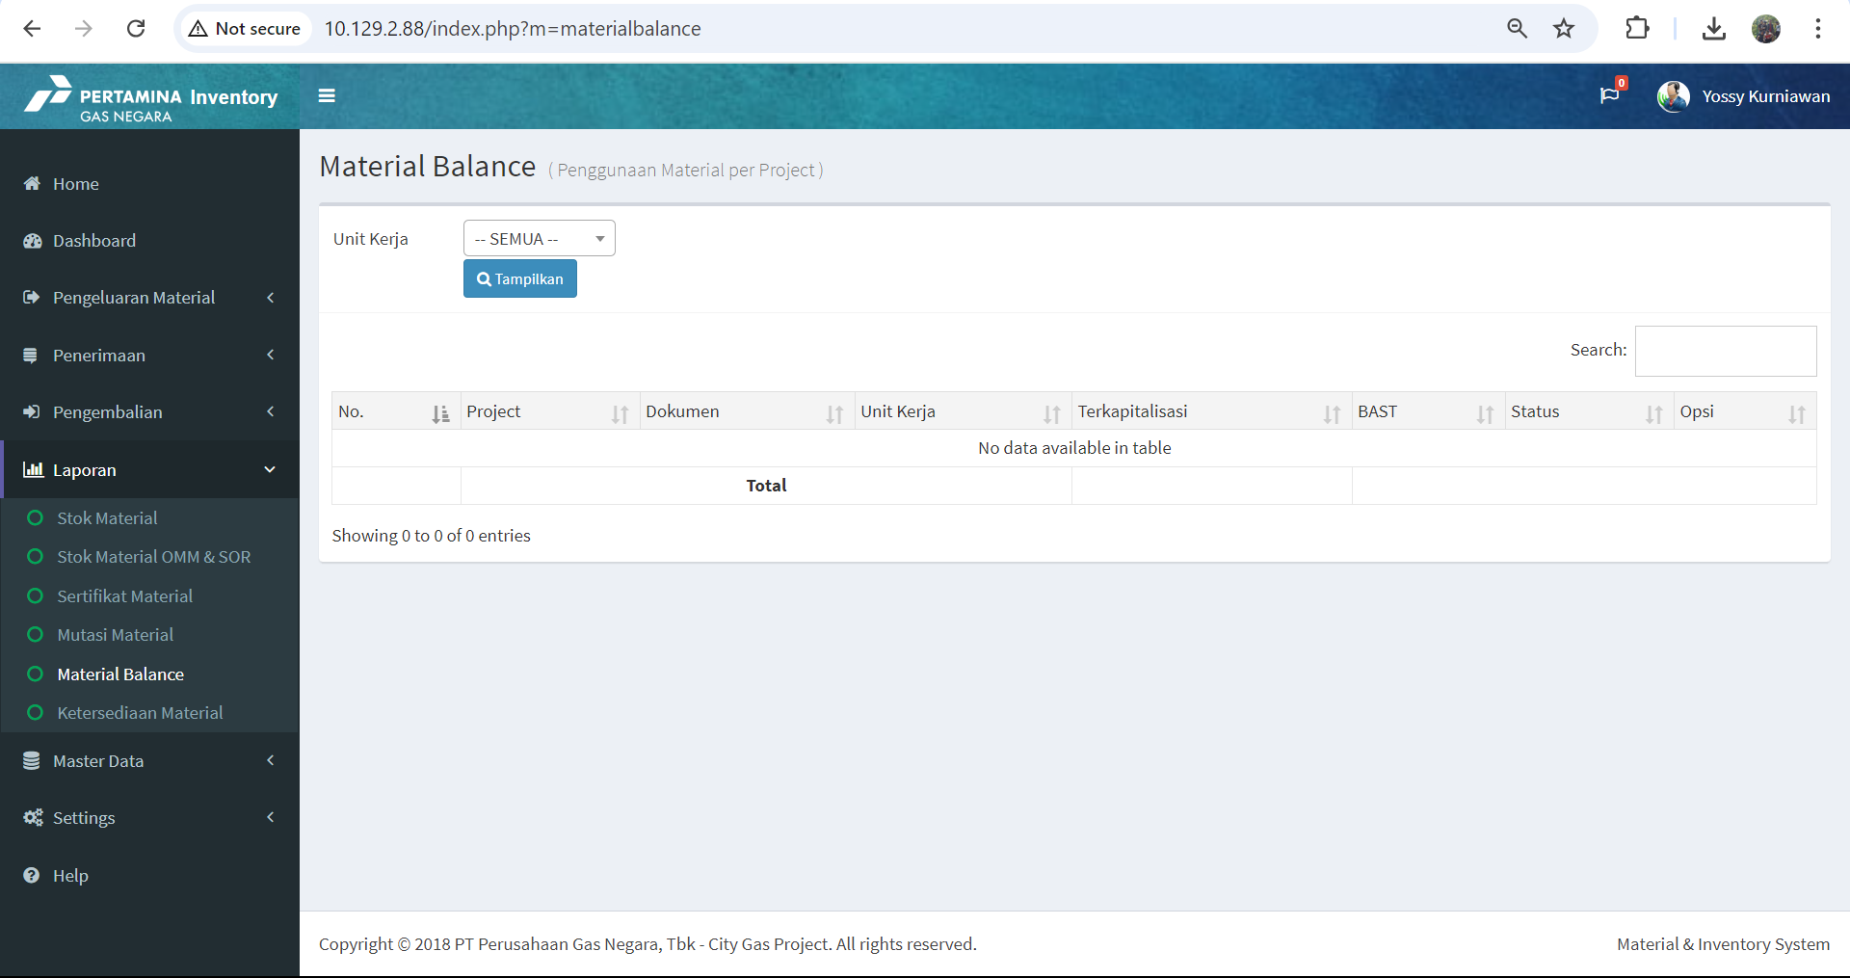
MODULE LAPORAN SIMACIGAS

Slide 16
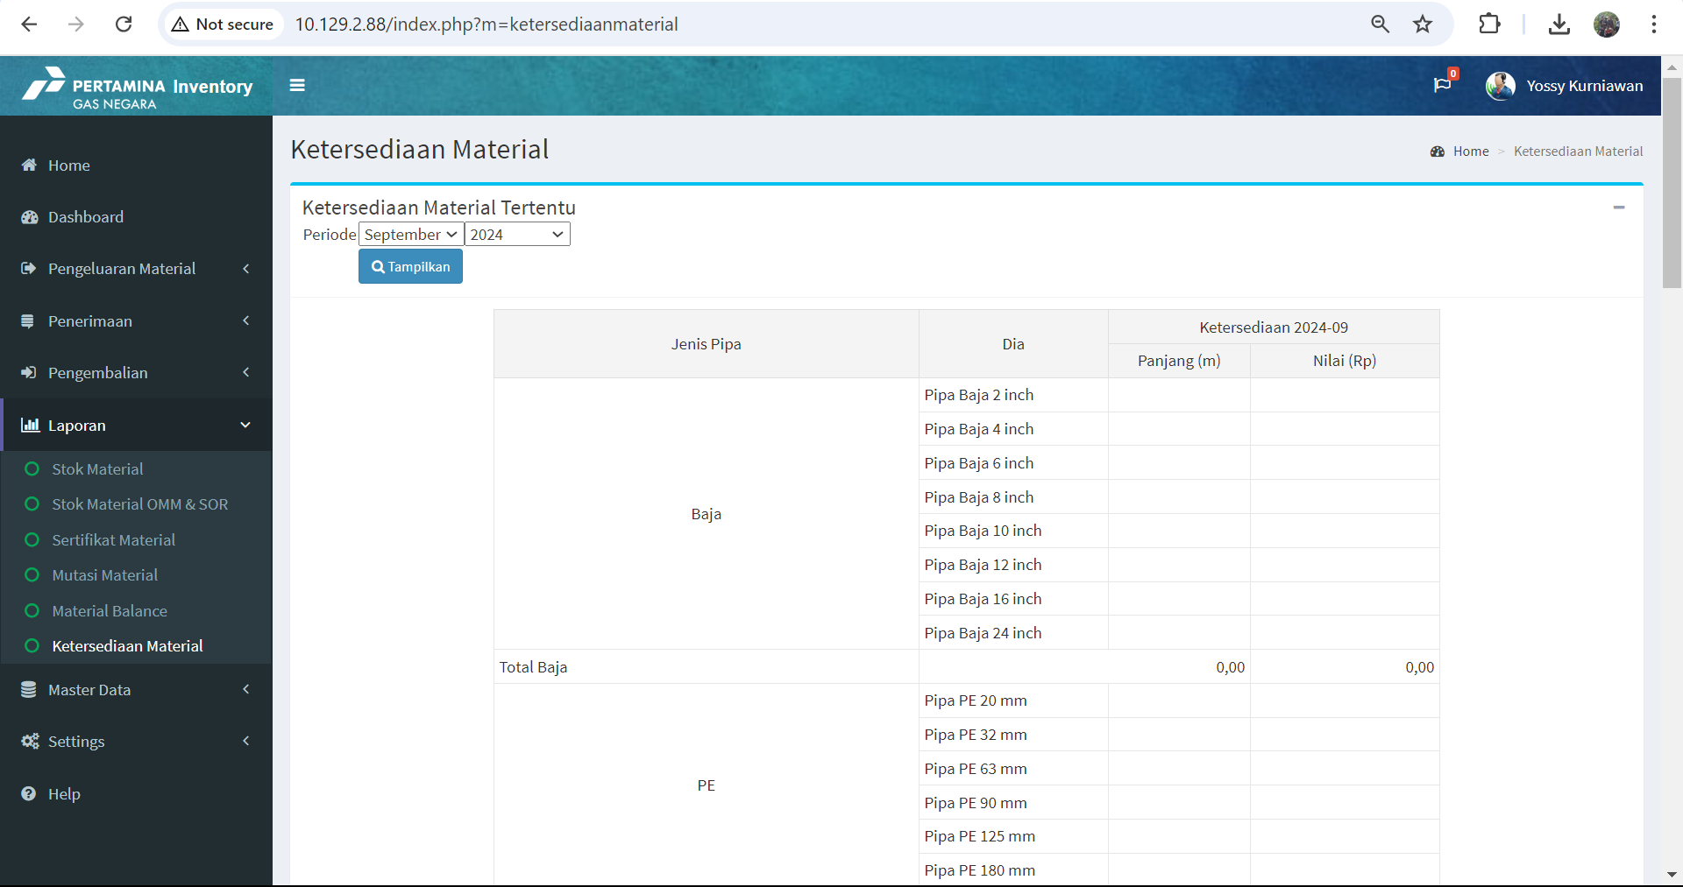
MODULE LAPORAN SIMACIGAS

Slide 17
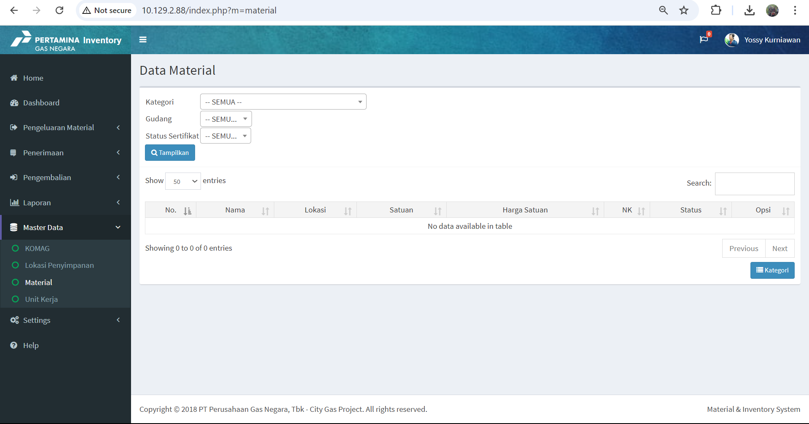
MODULE MASTER DATA SIMACIGAS

Slide 18
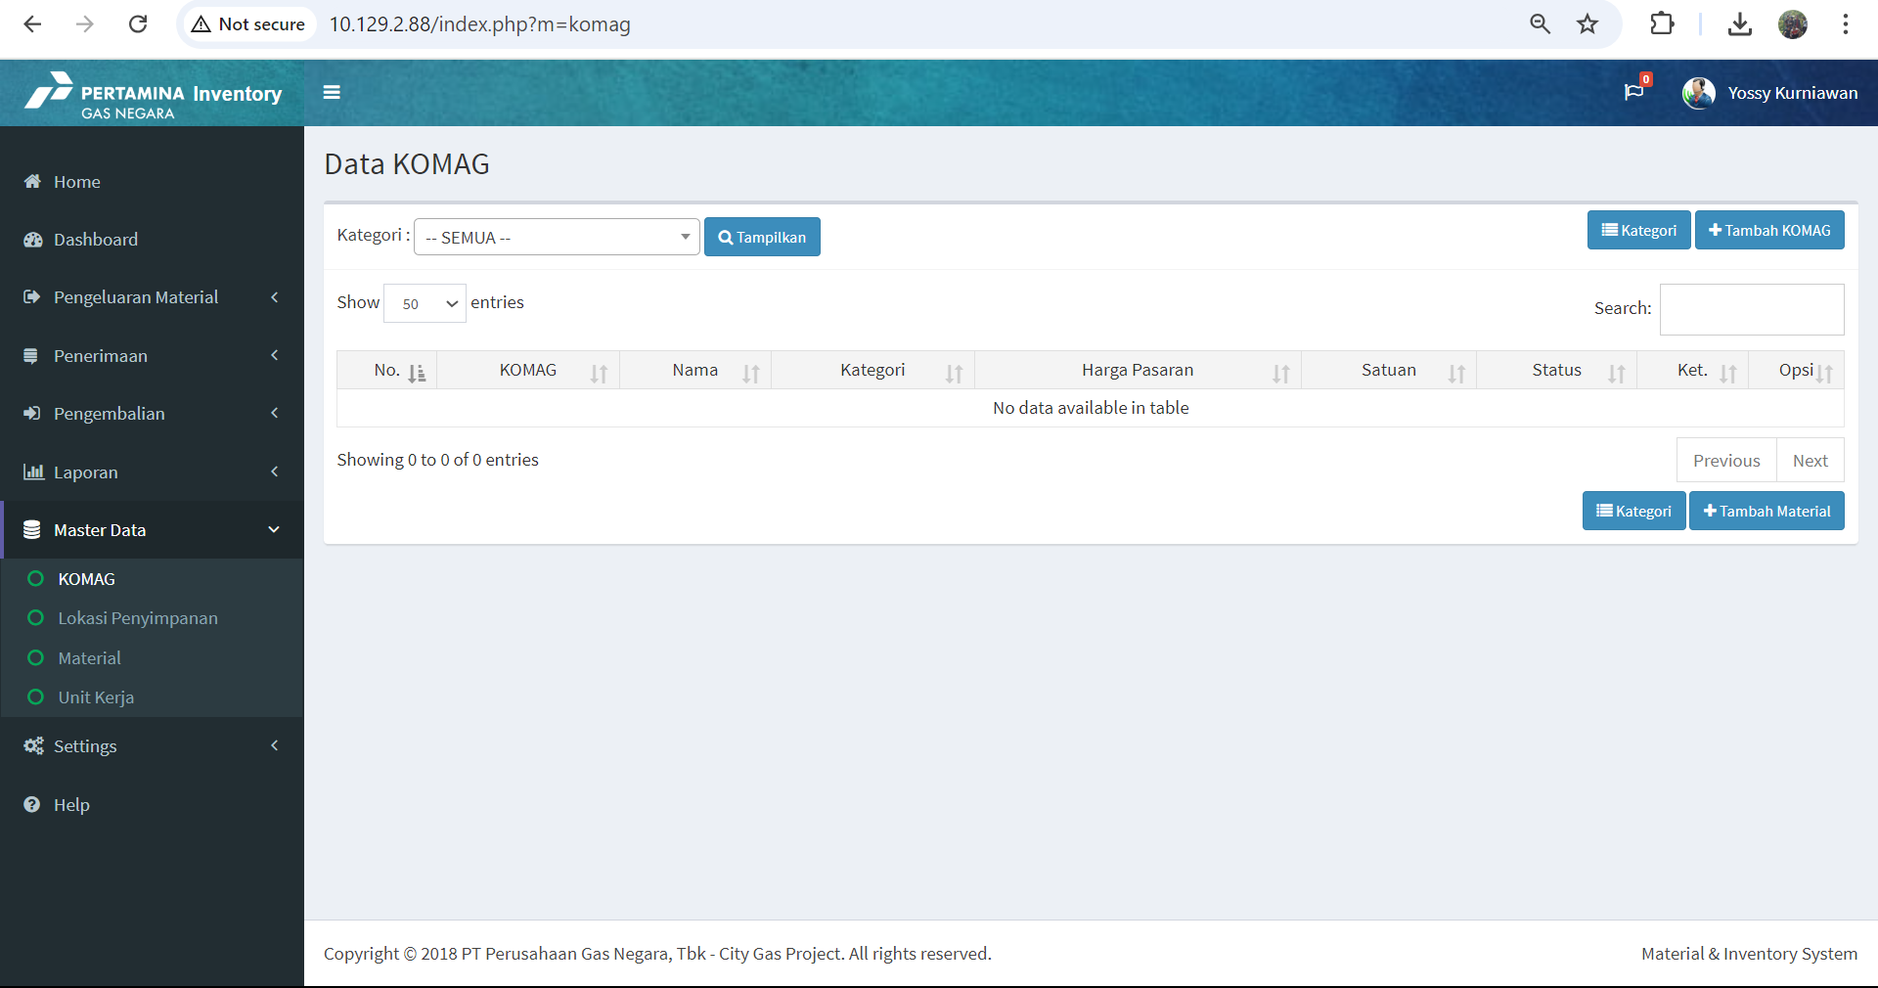
MODULE MASTER DATA SIMACIGAS

Slide 19
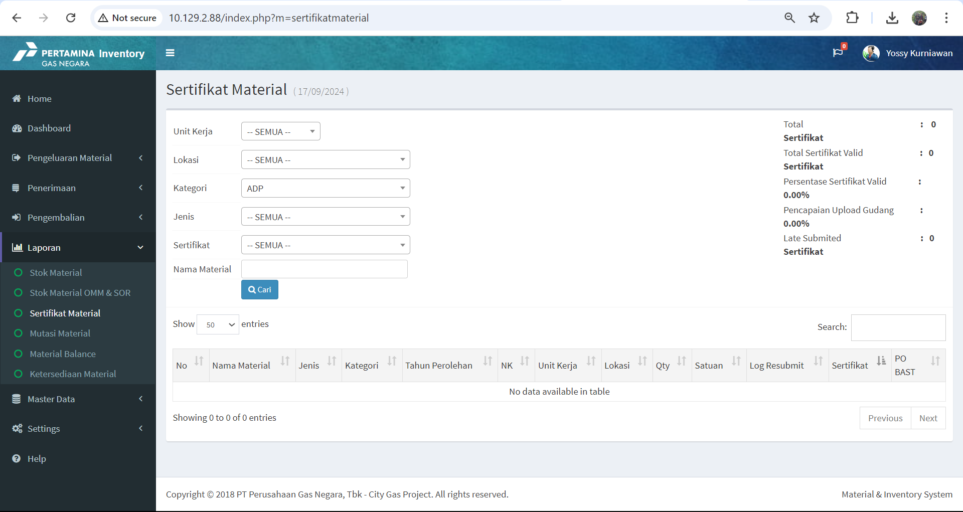
MODULE MASTER DATA SIMACIGAS

Slide 20

MODULE MASTER DATA SIMACIGAS

Slide 21
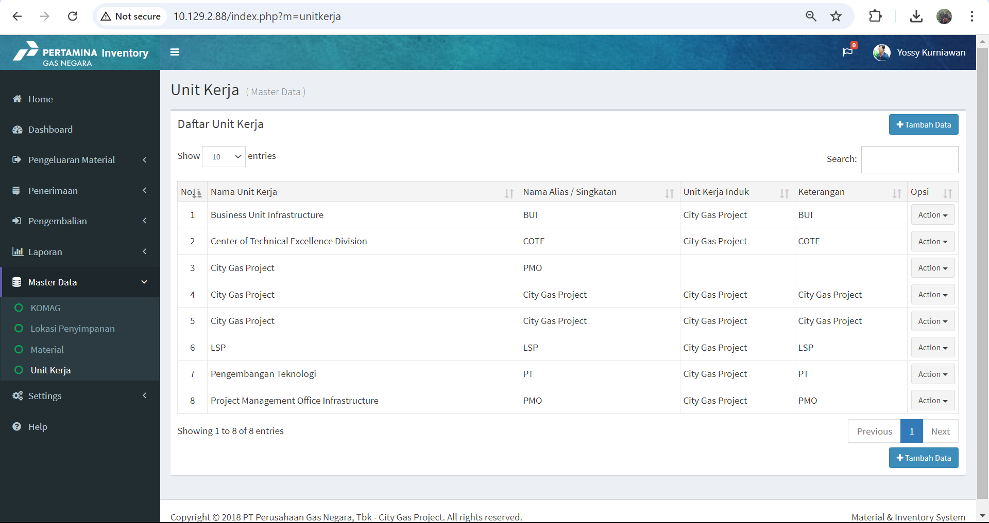
MODULE MASTER DATA SIMACIGAS

Slide 22
APLIKASI SIMACIGAS

Slide 23
APLIKASI SIMACIGAS

